Slide 1




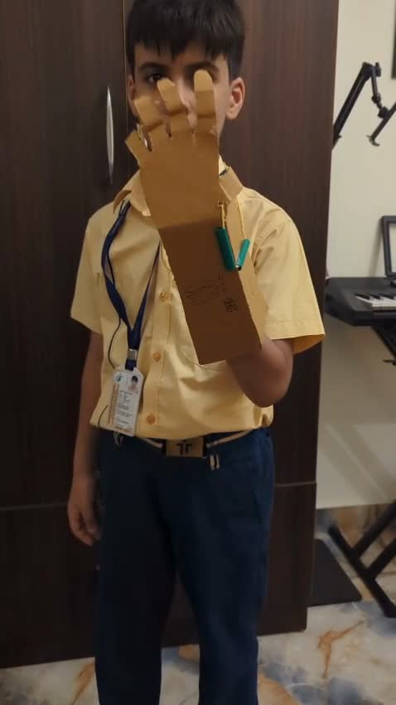

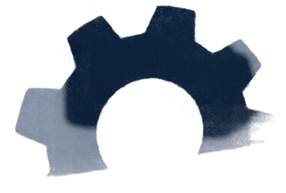
SIMPLE
MACHINES
ARTISTRY IN ACTION

Slide 2


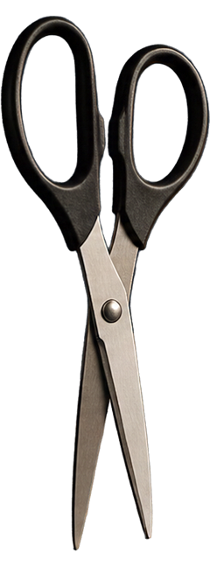
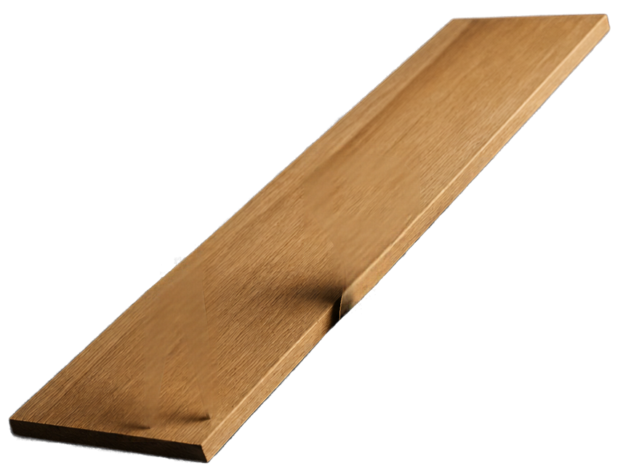
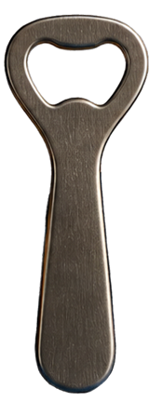
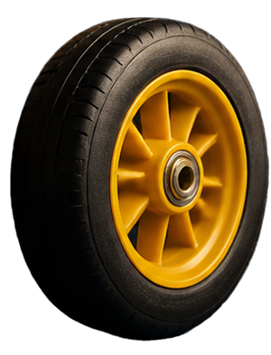

SIMPLE MACHINES,
BIG IDEAS
A simple machine is a basic mechanical device that helps us do a task more easily.
It usually has few or no moving parts.
Examples include scissors,
ramps, bottle openers and wheels.

Slide 3






SEE IT
IN ACTION
Watch it in action and
identify the simple machine.
LOOK FOR
which simple machine is used
WHERE
the effort is applied
WHAT
load the toy moves

