Slide 1



Simple
Machines
TAGORE INTERNATIONAL SCHOOL EOK
ARTISTRY IN ACTION · TOYS MAKING
How small machines make big work easy
Presented by [Student name], Class [__]
Notes:
Welcome parents. Today our class will show what we learned about simple machines and the toys we made. Mention the theme: Artistry in Action – Toys Making.

Slide 2
What is a simple machine?
A simple machine is a basic mechanical device that helps us do a task more easily. It usually has few or no moving parts.
Scissors
Ramps
Bottle openers
Wheels
“Work smarter, not harder!”
Simple Machines · Tagore International School EOK
2 / 12
Notes:
Read the definition aloud. Ask parents: which of these four did you use today? Other slogans to use: Small Machines, Big Solutions! / Simple Machines Make Hard Work Easy! / Less Effort, More Work! / From Wheels to Levers, Science Makes Life Better!

Slide 3
The six simple machines
1
2
3
Lever
Wheel and axle
Pulley
Turns around a fixed point
A wheel fixed to a rod
A rope over a grooved wheel
4
5
6
Inclined plane
Wedge
Screw
A sloping surface
A sharp, tapering edge
A slope wrapped around a rod
Simple Machines · Tagore International School EOK
3 / 12
Notes:
All other machines are built from these six. Next we look at each one.

Slide 4

Lever
MACHINE 1 OF 6
What it is
Where we see it
How it helps
A rigid bar that turns around a fixed point called the fulcrum.
Seesaw
Scissors
Crowbar
A small effort far from the fulcrum can lift a heavy load.
Simple Machines · Tagore International School EOK
4 / 12
Notes:
Key words: effort, load, fulcrum. Ask a child to show how a seesaw works.

Slide 5

Wheel and axle
MACHINE 2 OF 6
What it is
Where we see it
How it helps
A large wheel fixed to a smaller rod, the axle. Both turn together.
Bicycle
Door knob
Steering wheel
Turning the big wheel needs less force, and rolling reduces friction.
Simple Machines · Tagore International School EOK
5 / 12
Notes:
The axle is the small rod through the centre of the wheel. A door knob is a wheel and axle: the knob is the wheel.

Slide 6

Pulley
MACHINE 3 OF 6
What it is
Where we see it
How it helps
A grooved wheel with a rope or chain running over it.
Flagpole
Water well
Crane
It changes the direction of the pull, and several pulleys reduce the effort.
Simple Machines · Tagore International School EOK
6 / 12
Notes:
Pulling down on a flagpole rope raises the flag: the pulley changes the direction of the force.

Slide 7
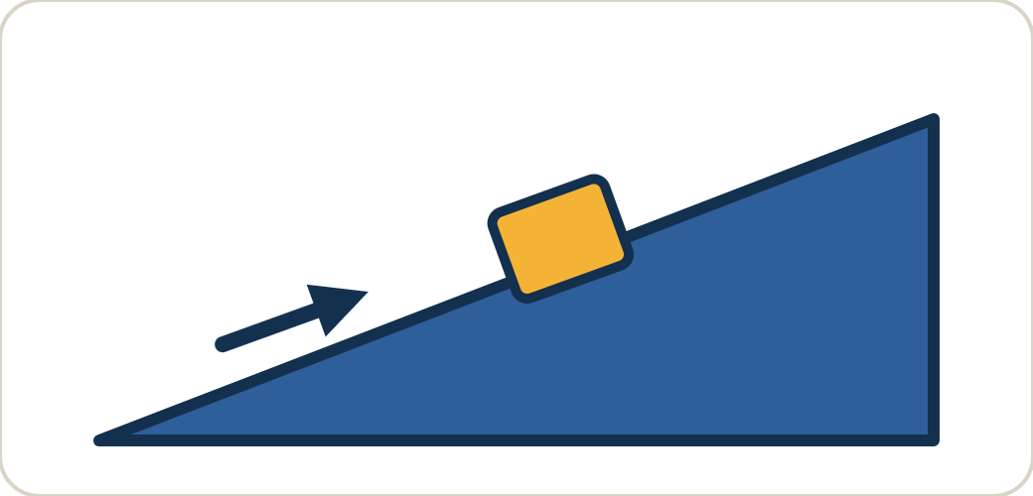
Inclined plane
MACHINE 4 OF 6
What it is
Where we see it
How it helps
A flat, sloping surface that joins a lower level to a higher one.
Ramp
Slide
Staircase
Pushing a load up a slope needs less force than lifting it straight up.
Simple Machines · Tagore International School EOK
7 / 12
Notes:
A longer slope means less effort but a longer distance to travel.

Slide 8

Wedge
MACHINE 5 OF 6
What it is
Where we see it
How it helps
Two inclined planes joined back to back to make a sharp edge.
Knife
Axe
Nail
It turns one push into a force that cuts or splits things apart.
Simple Machines · Tagore International School EOK
8 / 12
Notes:
The thinner the wedge, the easier it cuts.

Slide 9

Screw
MACHINE 6 OF 6
What it is
Where we see it
How it helps
An inclined plane wrapped around a rod to form a spiral thread.
Jar lid
Wood screw
Bottle cap
It turns a twist into forward motion and holds things tightly together.
Simple Machines · Tagore International School EOK
9 / 12
Notes:
Ask: which way do you turn a jar lid to open it?

Slide 10
Toys we made
Every toy uses at least one simple machine to move or work.
Toy | Simple machine | How it works
[Toy name] | [Machine] | [One line]
[Toy name] | [Machine] | [One line]
[Toy name] | [Machine] | [One line]
Simple Machines · Tagore International School EOK
10 / 12
Notes:
Fill in the table with the toys your class made, the simple machine each one uses and a one-line explanation. Delete any extra rows.

Slide 11
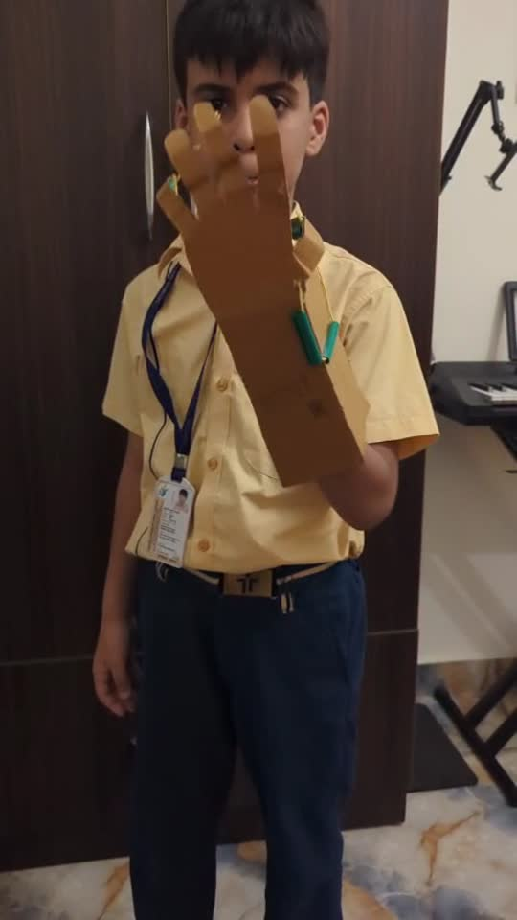
See it in action
A student shows the toy made in our Toys Making activity.
While watching, look for
Which simple machine is used
Where the effort is applied
What load the toy moves
Simple Machines · Tagore International School EOK
11 / 12
Notes:
Click the video frame to start it. Sound is on, so check the volume before the meeting. After it plays, ask parents which simple machine they spotted.

Slide 12
What the children learned
Creativity
Problem solving
Teamwork
Science at home
Turning ideas into toys
Building and sharing together
Fixing what did not work
Spotting machines every day
Thank you, parents!
“Simple ideas, amazing inventions!”
Simple Machines · Tagore International School EOK
12 / 12
Notes:
Close by thanking parents for supporting the activity. Invite questions about the toys and the science behind them.

